Slide 1

Windows PowerShell
System administration and automation in a Windows environment
- On scripts -
Karin De Maertelaere, Jochen Mariën

Slide 2
Scripting
You start writing (and copying) code into a PS ISE (or VSCode)-window and running it from there
But somewhere along the road, you’ll need to share this code
With a pimply-faced youth (PFY) for instance
…and you can’t expect them to understand all this code you wrote
So tune your scripts to be useable by coworkers

Slide 3
The . and the &
&
Call operator
To run a script that has spaces in it’s name
Will run the script in a separate scope, and remove the scope afterwards
.
Dot operator
To ‘dot source’ a script
Will run the script, but keep all functions and variables in the current scope
Useful to include a separate script with functions, variables, …

Slide 4
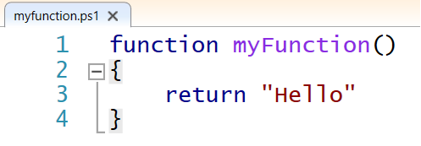
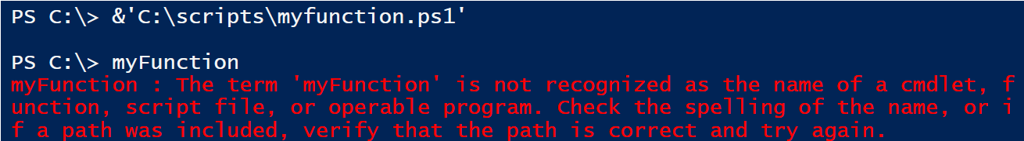
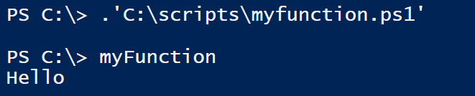
Examples
Run the script with &:
Dot source the script with . :

Slide 5
Debugging
When creating a script you sometimes want to “see what is going on”
In that case, use “Write-Debug”
The output of “Write-Debug” depends on the setting of $DebugPreference
Continue: PowerShell will show the debug message
Inquire: PowerShell will prompt the user
SilentlyContinue: PowerShell will not show the message
Stop: PowerShell will show the message and then halt
Ignore and Suspend: Not supported for an actionpreference variable
Advantage: you can leave the debugging in the script, even after you deploy it
Similarly: Write-Verbose
(The six year old that just won’t stop talking)

Slide 6
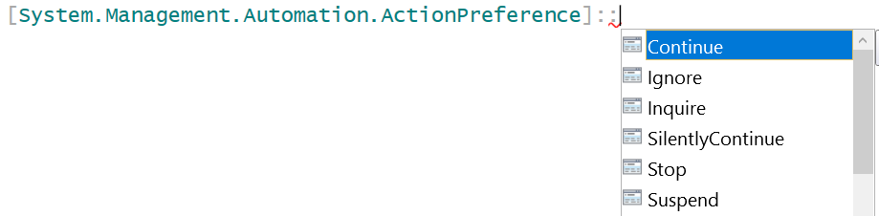
Write-Debug/Verbose
using namespace System.Management.Automation
$DebugPreference = [ActionPreference]::Continue
Write-Debug "Not completed"
$DebugPreference = [ActionPreference]::stop
Write-Debug "Not completed"
$DebugPreference = [ActionPreference]::Inquire
Write-Debug "Not completed"
$DebugPreference = [ActionPreference]::silentlycontinue
Write-Debug "Not completed"
Write-Debug "Not completed" -Debug
Notes:
$VerbosePreference = [ActionPreference]::Continue
Write-Verbose "More info."
$VerbosePreference = [ActionPreference]::stop
Write-Verbose "More info."
$VerbosePreference = [ActionPreference]::Inquire
Write-Verbose "More info."
$VerbosePreference = [ActionPreference]::silentlycontinue
Write-Verbose "More info."
Write-Verbose "More info." -Verbose

Slide 7
The execution policy
Get-ExecutionPolicy [-list]
Set-ExecutionPolicy
Restricted: No scripts can be run, PS can be used only in interactive mode
AllSigned: Only scripts signed by a trusted publisher can be run
RemoteSigned: Downloaded scripts must be signed by a trusted publisher
Unrestricted: No restrictions; all Windows PowerShell scripts can be run
Bypass: All scripts can be run, only possible on Process
On three different levels
Process: current PS-process
CurrentUser: current user
LocalMachine: all users of the computer
MachinePolicy
UserPolicy
Can be set without being an Administrator
Can only be set by Group Policy

Slide 8
Signing scripts
“Set-AuthenticodeSignature”
Which is nice, if you have a trusted root certificate
You can create one locally (self-signed), but that will only help you running scripts on your own computer
You can use the company-CA, and that would enable you to run all your scripts on all the company computers
You can get a commercial CA, and have your scripts available worldwide…

Slide 9
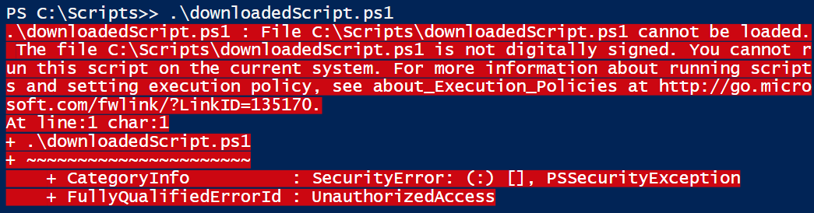
Is a script remote?
How does the computer distinguish between a downloaded script and a local script?
The problem:

Slide 10
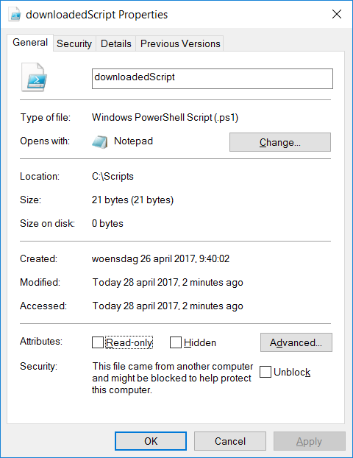
Is a script remote?
The reason (in a GUI):
Also the solution (in a GUI):
Or, the solution (in PS):
Unblock-File "downloadedScript.ps1"

Slide 11
Running a script
Doubleclick in Explorer
Default opens in notepad (fast!)
You can change this behaviour
Rightclick in Explorer – Edit (Bewerken)
Opens in ISE
Rightclick in Explorer – Run with PowerShell
Will always run with ByPass – execution policy
Start explicitly with Run
powershell.exe –noexit c:\scripts\test.ps1
powershell.exe –noexit &’c:\scripts\My script.ps1’
In Windows PowerShell console
A full path
A relative path with a dot first ( .\test.ps1 )
Only the name of the script if the path of the script is included in the path

Slide 12
Sudo su
It isn’t because your account is a member of the administrators, that every console you open uses these permissions (User Account Control)
Right click on PowerShell icon > run as administrator
In CLI (or ISE):
Start-Process PowerShell.exe –verb Runas
Runs a new CLI as Administrator
Only when the current user is a member of the administrators
Start-Process PowerShell.exe –verb Runasuser
To run as a different user
Start-Process PowerShell.exe –verb open
Simply open en new CLI (not elevated)
Start-Process PowerShell.exe -argumentlist nameScript
Executes one script in elevated mode
Start-Process powershell.exe -argumentlist "-executionpolicy bypass"
Start a new prompt with the executionpolicy bypassed

Slide 13
Errors: The classical way
try{
# code
5/0
}
catch [System.DivideByZeroException]{
"Catch System.DivideByZeroException exception"
# Use "Exit" to stop the script, without going to finally
# or other code behind the try/catch.
}
catch {
"Catch other exceptions"
}
finally {
"Always execute this code"
}

Slide 14
Errors: The new way
Trap traps any error in the script, not just the enclosed errors
In the trap-statement
Continue: continue with the script (default behavior)
Break: stop the script
$_: contains information on the error
You can add the specific type of error to catch ( [<exception type>] )
trap
{
"Error: $_"
"Error: " + $_.Exception.GetType().FullName
"Error: " + $_.Exception.Message
continue
}

Slide 15
Generating an error
Throw
Generates a terminating error in the script
Only used to stop a script immediately, not cleanly
Can be caught by trap and try-catch
vs. Write-Error
Generates a non-terminating error in the script
Will write an error to the default output (the screen, a logfile, …)
Can not be caught by trap and try-catch
Write-Error can cause a terminating error when the $ErrorActionPreference is set to "Stop"
Notes:
https://msdn.microsoft.com/en-us/powershell/reference/5.1/microsoft.powershell.core/about/about_throw

Slide 16
Parameters
When writing functions or scripts, you’ll need some parameters
For a quick and dirty function, simply put some variables
But even then, it’s good practice to choose describing names
You can refer to the variables in order
Or by name
function deduction
{
param($a, $b)
return $a - $b
}
deduction 7 5
deduction -b 5 -a 7

Slide 17
Strongly typed
If you know the datatype of the parameters, strongly type them
This will prevent errors in the function
(and create errors when calling the function)
function deduction
{
param([int] $a, [int] $b)
return $a - $b
}

Slide 18
Initialised parameter
A parameter that doesn’t have to be passed to the function, but can
Valid calls for the function:
function deduction
{
param([int] $a = 0, [int] $b = 10)
return $a - $b
}
deduction 7 5 # 7-5 = 2
deduction 7 # 7-10 = -3
deduction # 0-10 = -10
deduction -b 5 # 0-5 = -5

Slide 19
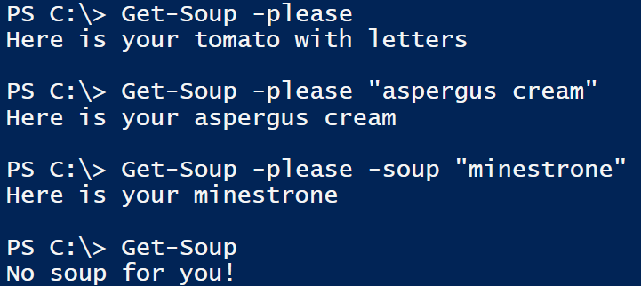
Switch parameter
A switch parameter can’t have a value, but can be present (or not)
Can be used as a Boolean variable in the function
function Get-Soup
{
param([switch]$please, [string]$soup="tomato with letters")
if ($please)
{
return "Here is your $soup"
}
else
{
return "No soup for you!"
}
}

Slide 20
Switch parameter
A switch is either present, or not present
This results in a $true or $false value
Making a switch default to $false is useless
A switch that is not present is always false
Making a switch default to $true is difficult
How would you turn the switch off, because if it’s not present, it will be true
Making a switch mandatory is also difficult
You force the use to have the switch, thereby turning it on
You can “forcibly turn off” a switch
By using a colon between the switch-name and the $false
Sometimes needed to turn of confirmation-screens
Get-Soup -please:$false

Slide 21
Bad practices
function deduction($a, $b)
{
$a - $b
}
Return values without using return
Works, but leads to the next bad practice
Return more than one value
How would the script calling this function process this value?
Impossible when using return because return ends the function
Writing from the function
Functions should silently do what they are supposed to, and not be to verbal about it
If we want to print what we are doing, the main script will
Ok to use: Write-Error and Write-Verbose
function deduction($a, $b)
{
"You're deducting"
$a - $b
}
function deduction($a, $b)
{
Write-Host "You're deducting"
return $a - $b
}

Slide 22
Requires
https://technet.microsoft.com/en-us/library/hh847765.aspx
#Requires can be used to require
Administrator-rights (-RunAsAdministrator)
A certain minimum version of PowerShell (-version 4.0)
An installed module (-module ActiveDirectory)
Can be used multiple times for different requirements

Slide 23

Get-ComputerSystem
A demo on how to write and fine-tune a script

Slide 24
What was in the demo
about_Functions_Advanced_Parameters
https://docs.microsoft.com/en-us/...
about_Comment_Based_Help
https://docs.microsoft.com/en-us/...

Slide 25
Summing up
In this presentation we talked about how to ‘publish’ a script
If the script is strictly for personal use, you don’t have to go too deep into commenting and adding parameters
But you-two-years-from-now is a different person from you-now…
This and the previous presentations combined give you an insight into how PowerShell works
Next up is diving deeper into certain topics (ActiveDirectory, NTFS, …)
But the basic principals remain…

